Slide 1

Intro to spectral graph analysis
By Isaac Gutierrez Ruiz
02-13-2025

Slide 2
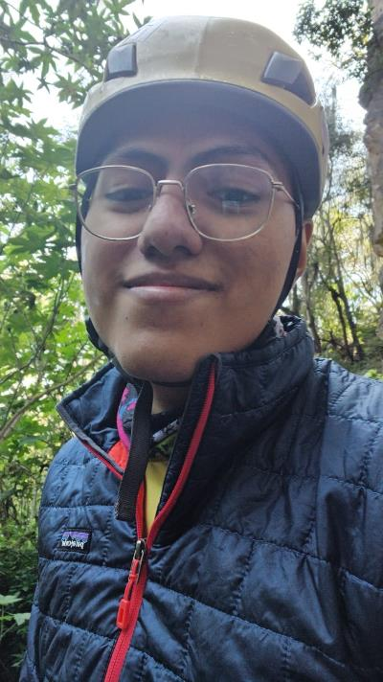
I’m Isaac Gutierrez Ruiz
From Data as Machine Learning Engineer

Slide 3

Agenda
What is clustering?
Why do we need alternatives to classical clustering methods?
Graph theory / Computer science approach to clustering
Basic Graph theory concepts
Eigenvector and eigenvalues of a Laplacian
Spectral clustering algorithm

Slide 4
What is clustering?

Slide 5
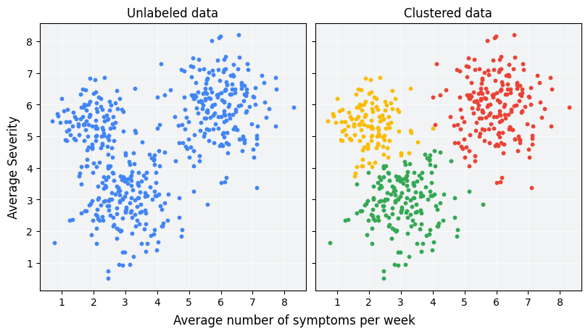
What is clustering?
Clustering is an unsupervised machine learning technique designed to group unlabeled examples based on their similarity to each other.

Slide 6
Why do we need alternatives to classical clustering methods?

Slide 7
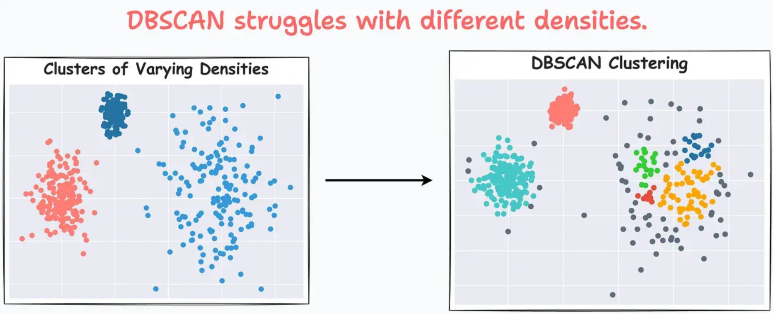
Why do we need alternatives to classical clustering methods?

Slide 8
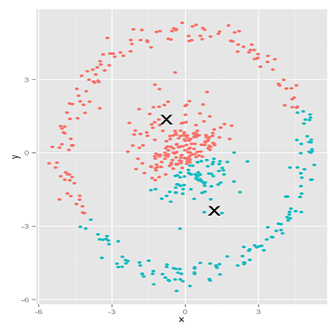
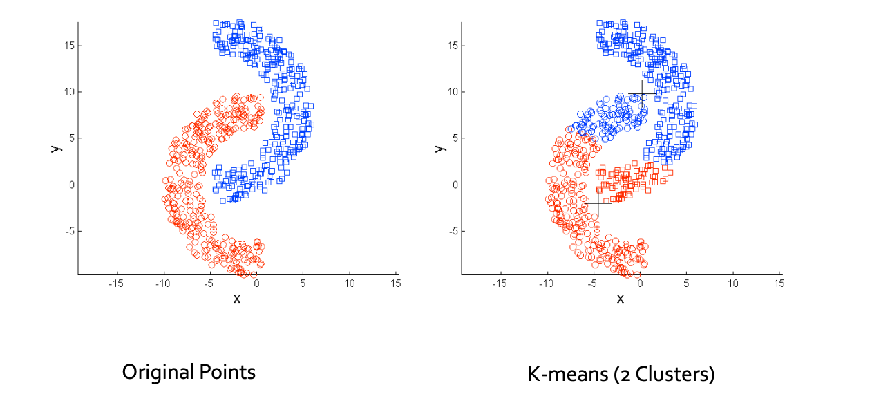
Why do we need alternatives to classical clustering methods?
K-means assumes clusters are convex and spherical, which can fail for more complex shapes.

Slide 9
Graph theory / Computer science approach to clustering

Slide 10
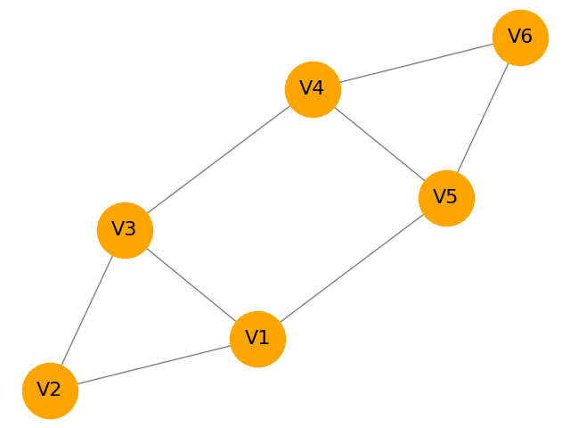
Graph theory / Computer science approach to clustering
Graph clustering or community detection is a partitioning problem in graph theory where the goal is to divide a graph into subsets of node.
We do this by:
Maximized connection inside the subset.
Minimizing connection outside the subset.

Slide 11
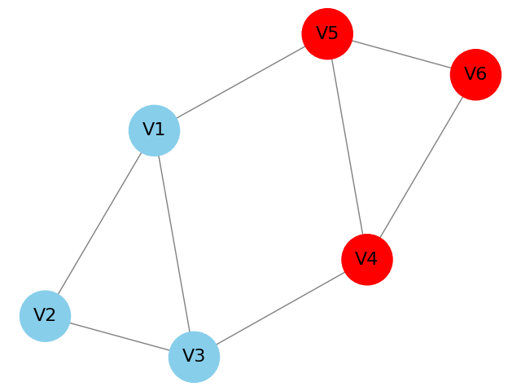
Graph theory / Computer science approach to clustering
Graph clustering or community detection is a partitioning problem in graph theory where the goal is to divide a graph into subsets of node.
We do this by:
Maximized connection inside the subset.
Minimizing connection outside the subset.

Slide 12
Basic Graph theory concepts

Slide 13
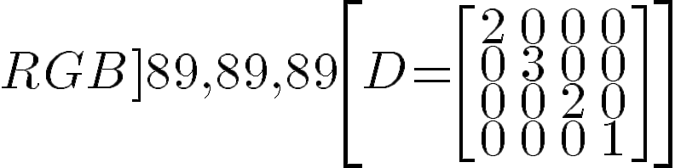
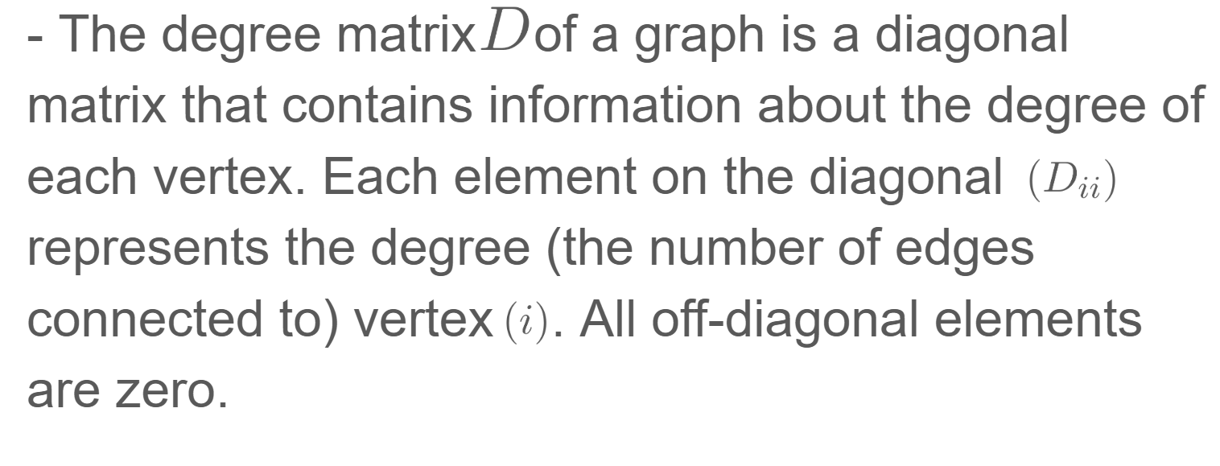
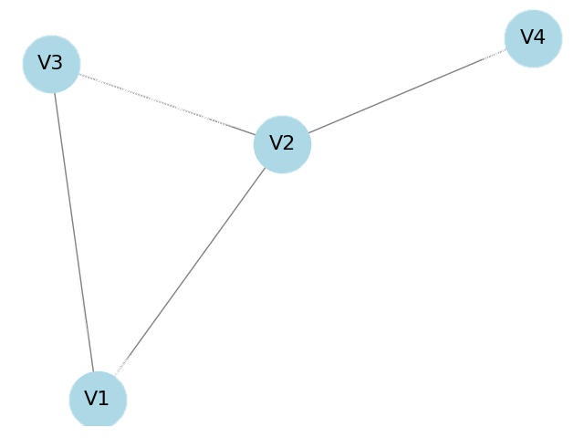
Basic Graph theory concepts

Slide 14
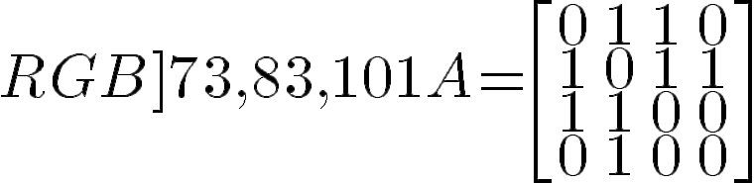
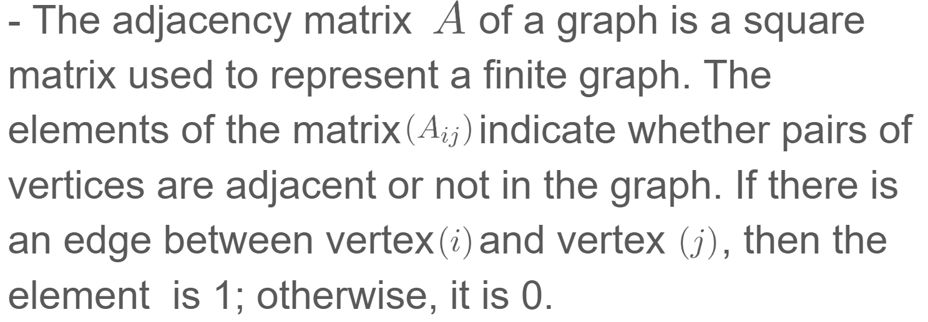
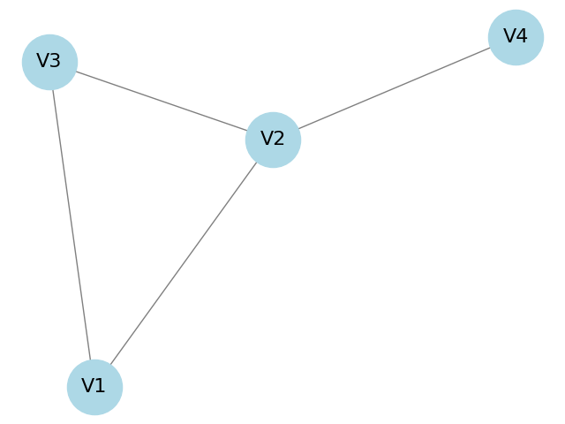
Basic Graph theory concepts

Slide 15
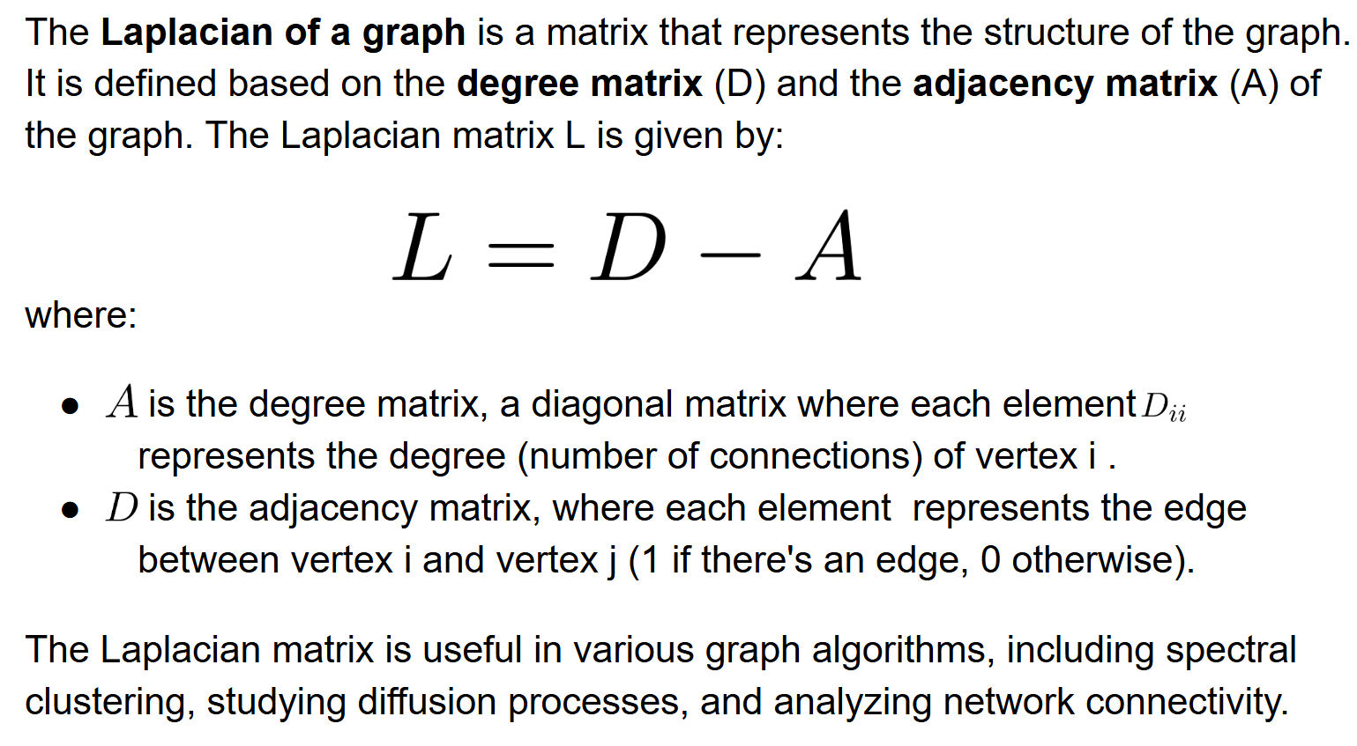
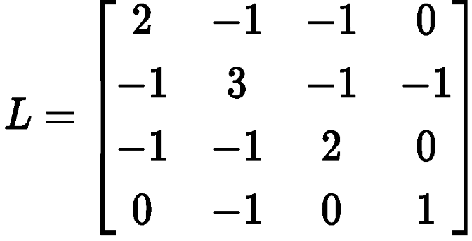
Basic Graph theory concepts

Slide 16
Eigenvector and eigenvalues of a Laplacian

Slide 17
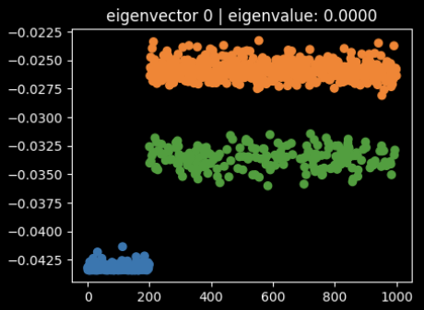
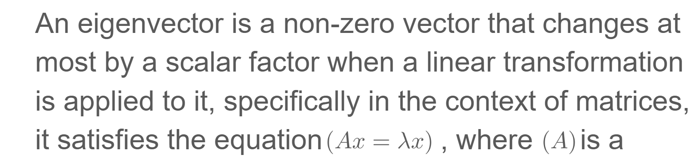
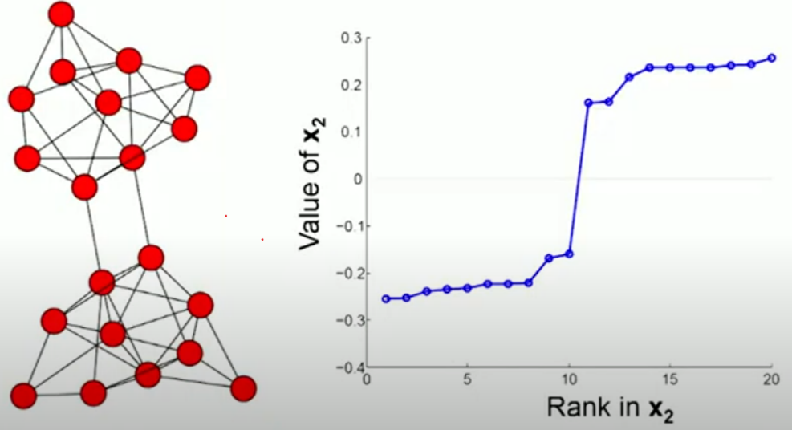
Eigenvector and eigenvalues of a Laplacian
The eigenvectors of the Laplacian provide insights into the graph's structure; specifically, they can be used to find clusters or communities within the graph.

Slide 18
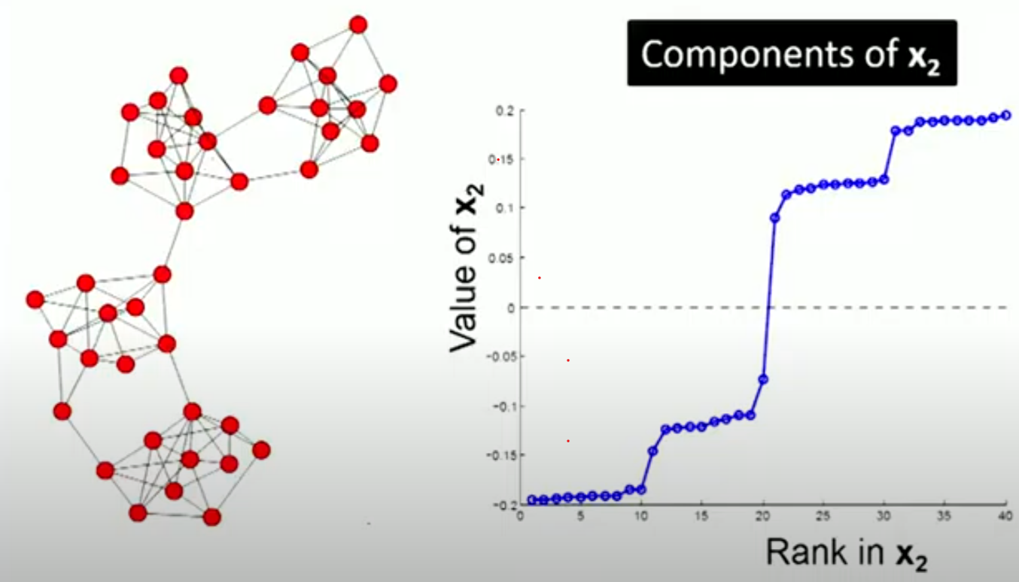
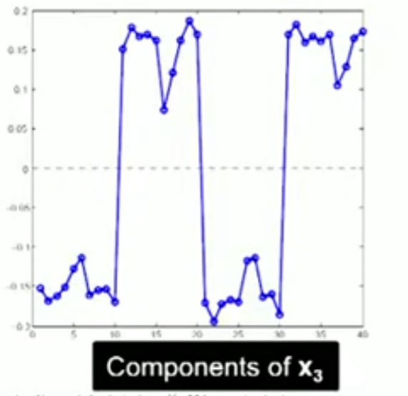
Graph Example

Slide 19
Spectral clustering algorithm

Slide 20
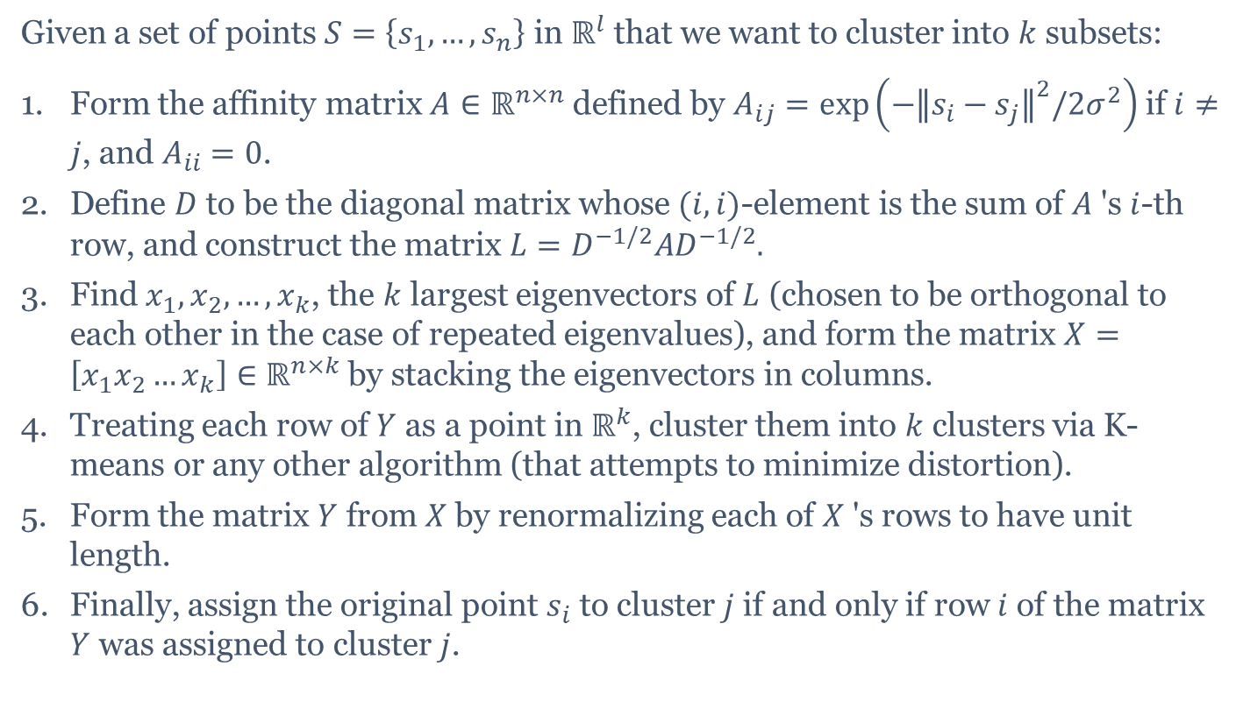
Spectral clustering algorithm
Given a set of points $S=\left\{s_{1},…,s_{n}\right\}$ in $ℝ^{l}$ that we want to cluster into $k$ subsets:
Form the affinity matrix $A∈ℝ^{n×n}$ defined by $A_{ij}=exp⁡\left(−{∥s_{i}−s_{j}∥}^{2}/2σ^{2}\right)$ if $i≠j$, and $A_{ii}=0$.
Define $D$ to be the diagonal matrix whose $(i,i)$-element is the sum of $A$ 's $i$-th row, and construct the matrix $L=D^{−1/2}AD^{−1/2}.$
Find $x_{1},x_{2},…,x_{k}$, the $k$ largest eigenvectors of $L$ (chosen to be orthogonal to each other in the case of repeated eigenvalues), and form the matrix $X=$ $\left[x_{1}x_{2}…x_{k}\right]∈ℝ^{n×k}$ by stacking the eigenvectors in columns.
Treating each row of $Y$ as a point in $ℝ^{k}$, cluster them into $k$ clusters via K-means or any other algorithm (that attempts to minimize distortion).
Form the matrix $Y$ from $X$ by renormalizing each of $X$ 's rows to have unit length.
Finally, assign the original point $s_{i}$ to cluster $j$ if and only if row $i$ of the matrix $Y$ was assigned to cluster $j$.

Slide 21
Q & A

Slide 22
Don’t forget to submit your IC points!!!

Slide 23
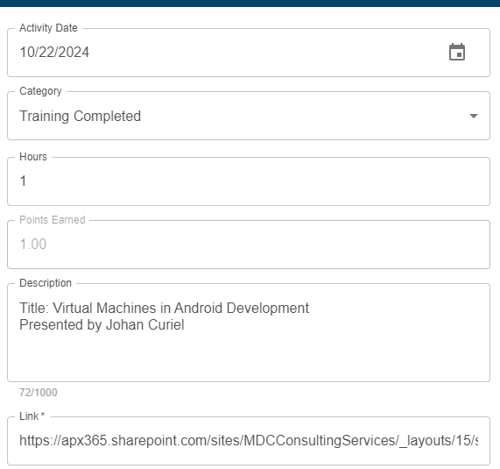
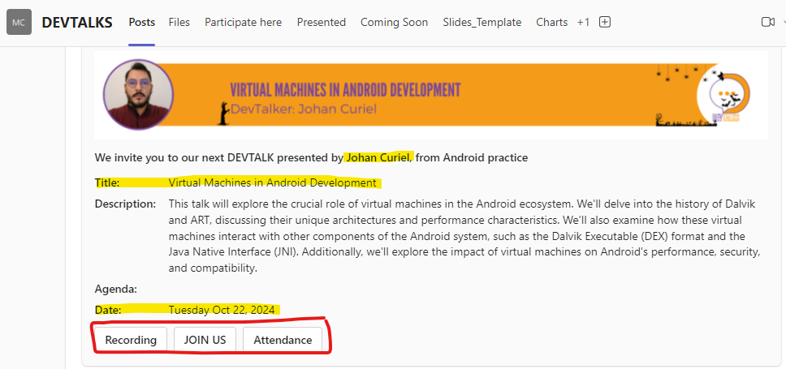
How to register my IC Points?

Slide 24
Keep Growing!

Slide 25
United Efforts, Singular Vision: Your Success!
Communication Program
Lunch & Learn
DEVTALKS
English Leadership Program
Whether you are looking to overcome stage fright, refine your oratory skills, or develop leadership abilities, our program warmly welcomes participants of all skill levels.
Benefits for Presenters:
Professional development, practice public speaking skills in English.
Develop your technical and communication skills
Share your knowledge
Connect and grow
Earn IC points for Developing training
Benefits for Presenters:
Practice public speaking skills in English or Spanish
Develop your technical and communication skills
Share your knowledge
Connect and grow
Earn IC points for Developing training
English conversation club
The objective of English Conversation Club is to improve English skills among MDC employees; The goal is to allow members practice speaking and listening in an informal and relaxed environment.
The Club focuses on providing an opportunity to speak regularly in small groups; These groups are facilitated/conducted by a Moderator who will lead the session.
Benefits for Attendees
You can learn something new every Lunch and learn presentation
Every Lunch and Learn is recorded and available for everybody via Percipio
Earn Training Completed IC points for joining the call or viewing the presentation later via the Percipio presentation link.
Benefits for Attendees:
Every week you can learn something new
Every Devtalk is recorded and available for everybody
Earn Training Completed IC points for joining the call or viewing the presentation recorded later

Slide 26

Thank you!

